Slide 1
Introduction
Key Message
This involves; listening, taking turns, understanding and talking
Most of all it is about interacting and having fun.

Slide 2
Hello
Key Message
Rhymes and singing are great ways to promote early language skills.

Slide 3
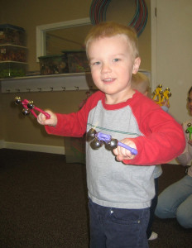
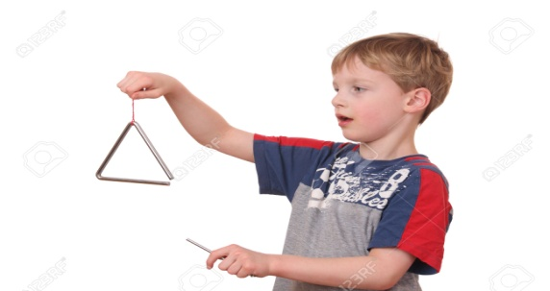
Listening games
Key Message
Listening is really important to encourage your child’s language development.

Slide 4
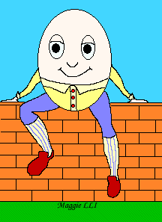
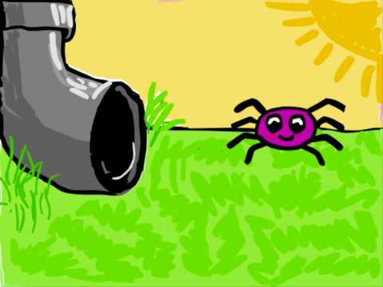
Singing and taking turns
Key Message
Singing helps children learn language because it is repetitive and rhymes help children predict the words that will follow. They also help children get interested in words, rhythm and rhyme.

Slide 5
Learning words
Key Message
Learning vocabulary or words if the key to children’s learning. Learning to talk will encourage good reading later on.

Slide 6
Stories
Key Message
Storeis are great for teaching children new words and learning to put words into sentence. Stories do not have to be with books. Making up stories is fun! If your children can learn to do this verbally they will be better at writing stories at school.

